Slide 1


Team GeekPie_HPC ShanghaiTech University
ISC23 Student Cluster Competition

Slide 2
Agenda
About the team
Applications
POT3D
FluTAS
QE
Innovation

Slide 3


The Team
Aibo Hu
GeekPie_HPC Team Leader, Sophomore
Interesting Area: Parallel Computing, Algorithm
Zecheng Li
GeekPie_HPC Teammate, Senior
Interesting Area: Performance Analysis, Parallel Computing
Zongze Li
GeekPie_HPC Teammate, Junior
Interesting Area: Database, Operating System
Yichi Zhang
GeekPie_HPC Teammate, Sophomore
Interesting Area: Operating Systems, Compilers
Lei Huang
GeekPie_HPC Teammate, Sophomore
Interesting Area: Complexity, Formal Languages
Rui Fan
GeekPie_HPC Advisor
Parallel and distributed computing, design of efficient algorithms and algorithmic solutions to problems on large datasets
Xuanjun Wen
GeekPie_HPC Teammate, Sophomore
Interesting Area: Linux Operations and Maintenance

Slide 4
The Team
POT3D
Aibo Hu
Xuanjun Wen
FluTAS
Yichi Zhang
Lei Huang
QE
Zecheng Li
Zongze Li

Slide 5
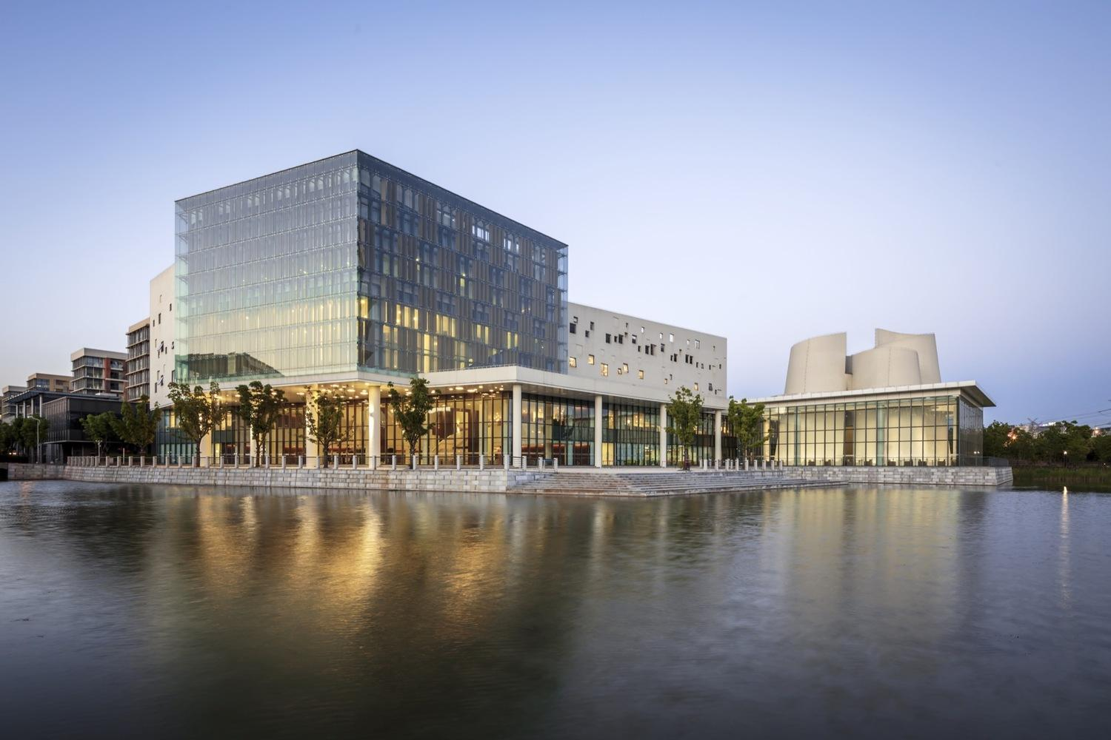
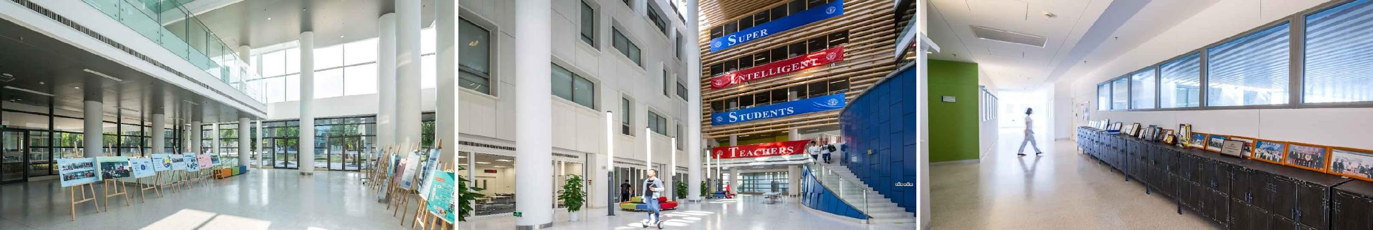
ShanghaiTech University
Aspire to be a small-scale, high-level, international university oriented towards research and innovation.

Slide 6

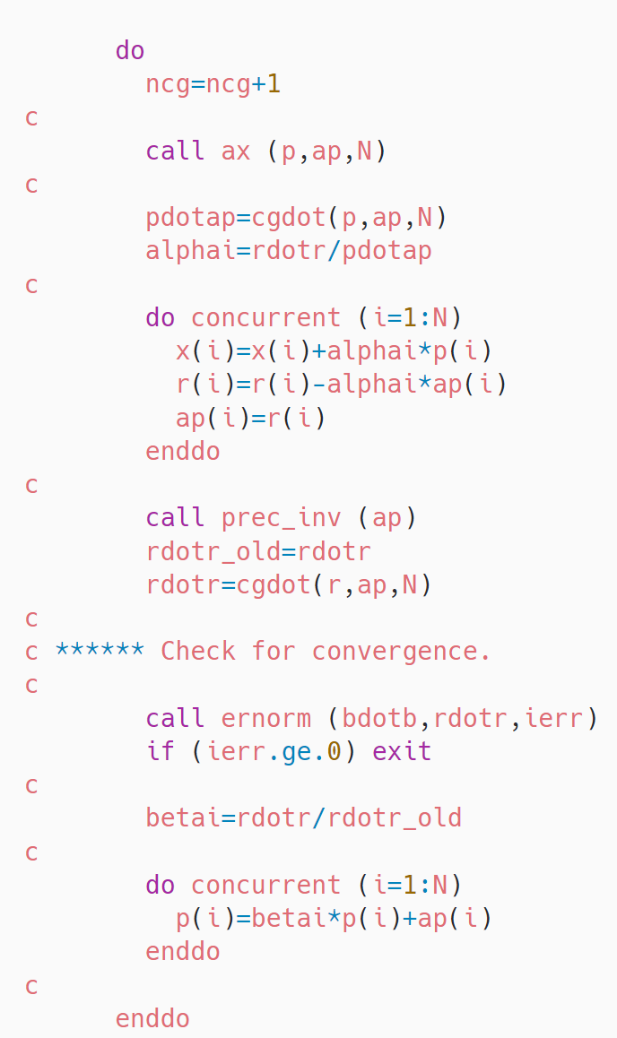
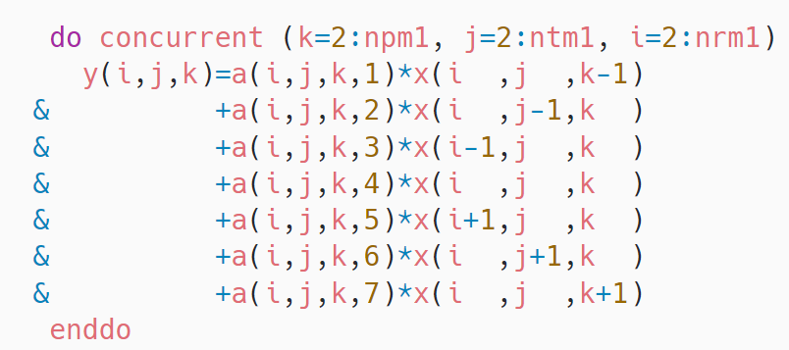
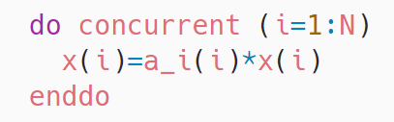
Solves the 3D Laplace equation on a nonuniform logically-rectangular spherical grid
Using an iterative Preconditioned Conjugate Gradient

Slide 7
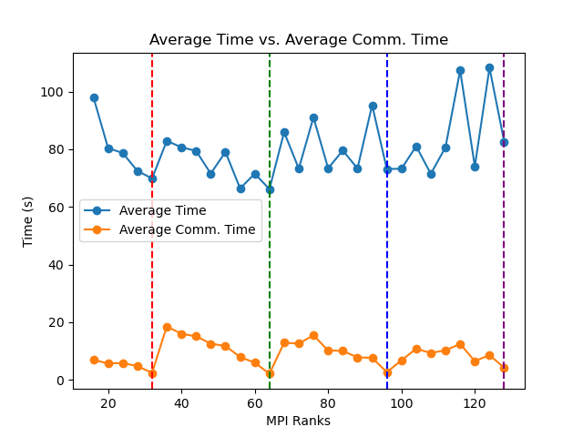
MPI Tuning on Bridges-2
At first we do some experiments. 1 node Bridges-2, “small” testsuite
32, 64, 96, 128-rank are “local optimal”
Especially communication time
Guess there may be work imbalance if rank != 32, 64, 96.

Slide 8
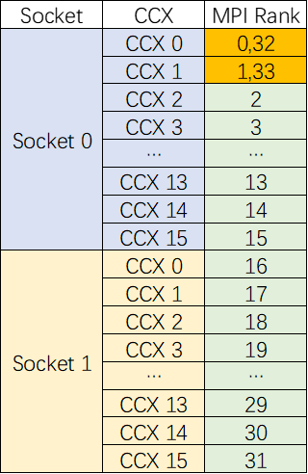
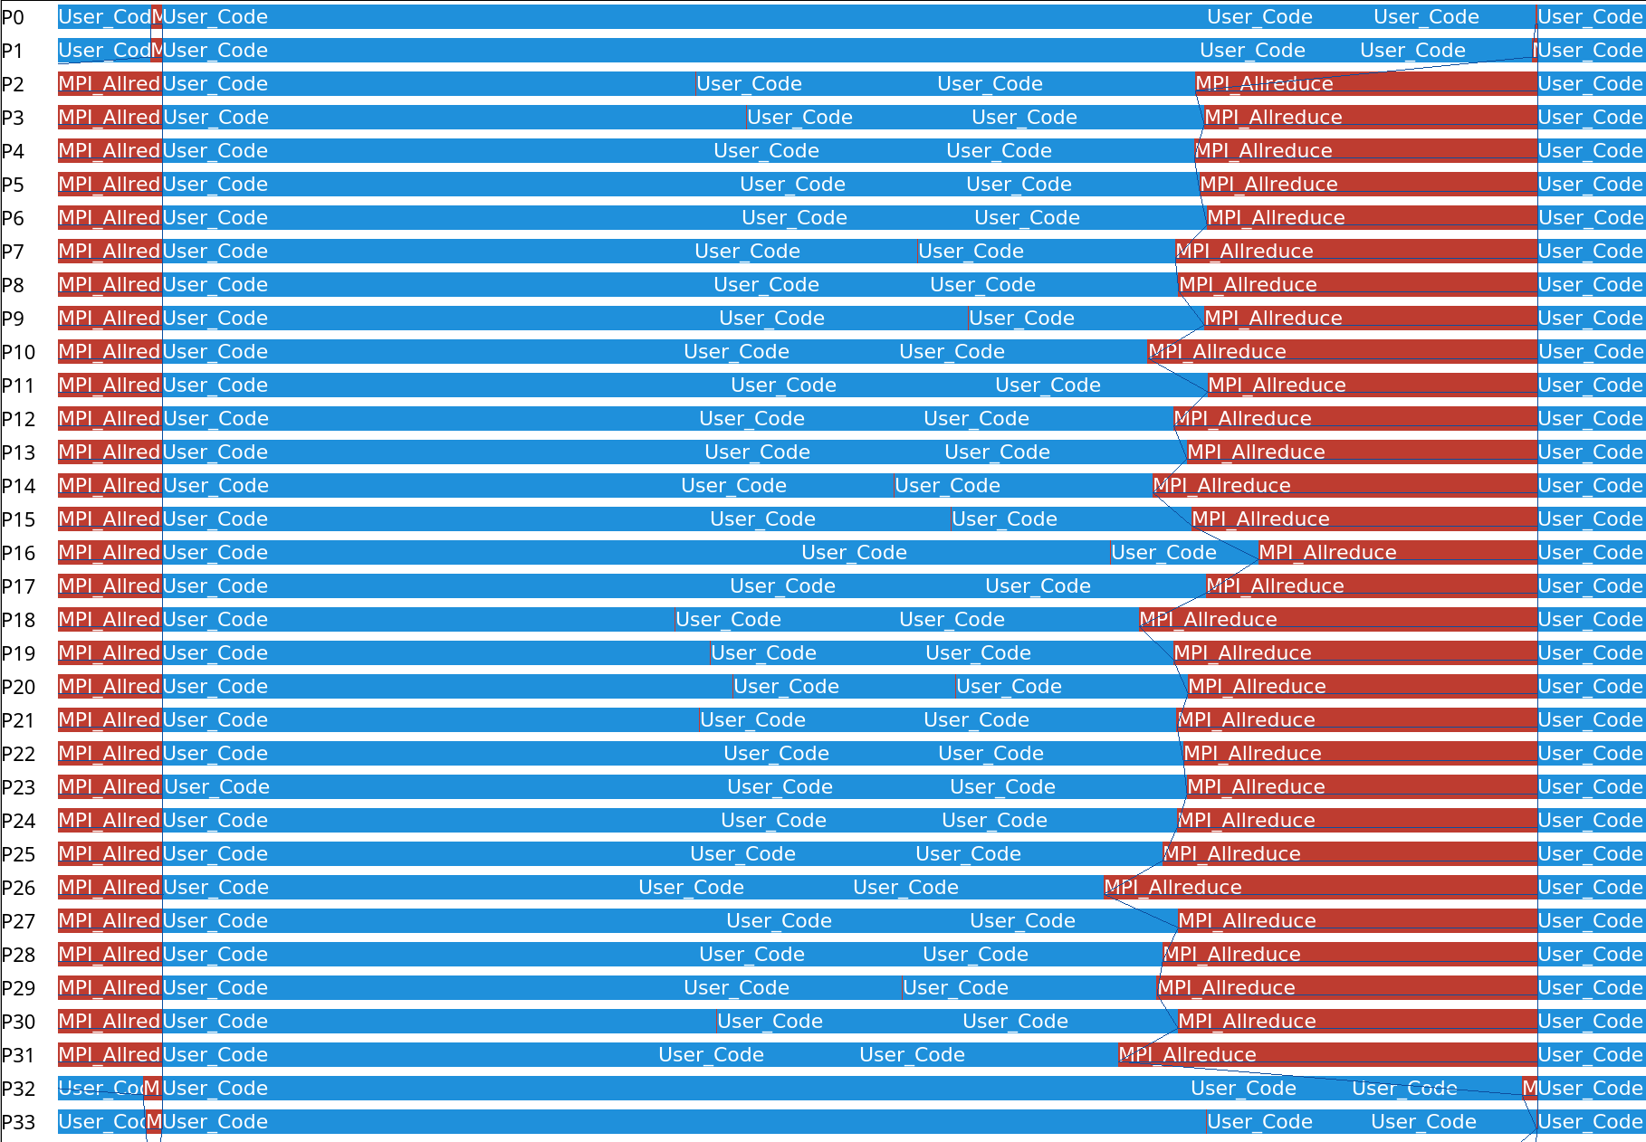
MPI Tuning on Bridges-2
We use ITAC because we can see the event timeline. (34 ppn, 4 nodes, Bridges-2)
Some ranks computes slower than other ranks. The program have to wait the slowest ranks when calling “Allreduce”

Slide 9
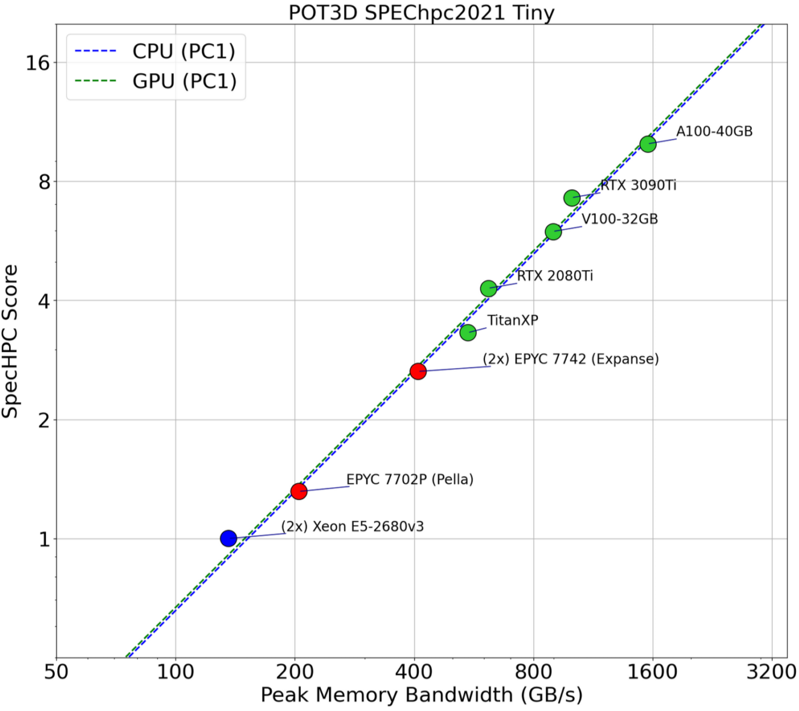
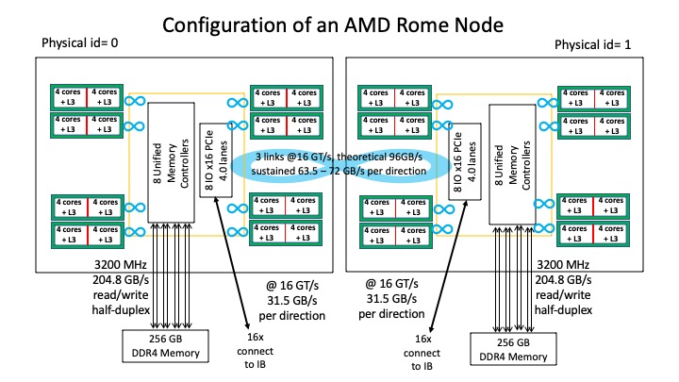
MPI Tuning on Bridges-2
Why some ranks are slower? 🤔
POT3D is memory bound
EPYC 7742, 4 cores share L3cache
Workload imbalance cause more cache miss
2 processes/CCD is able to utilize the entire bandwidth

Slide 10
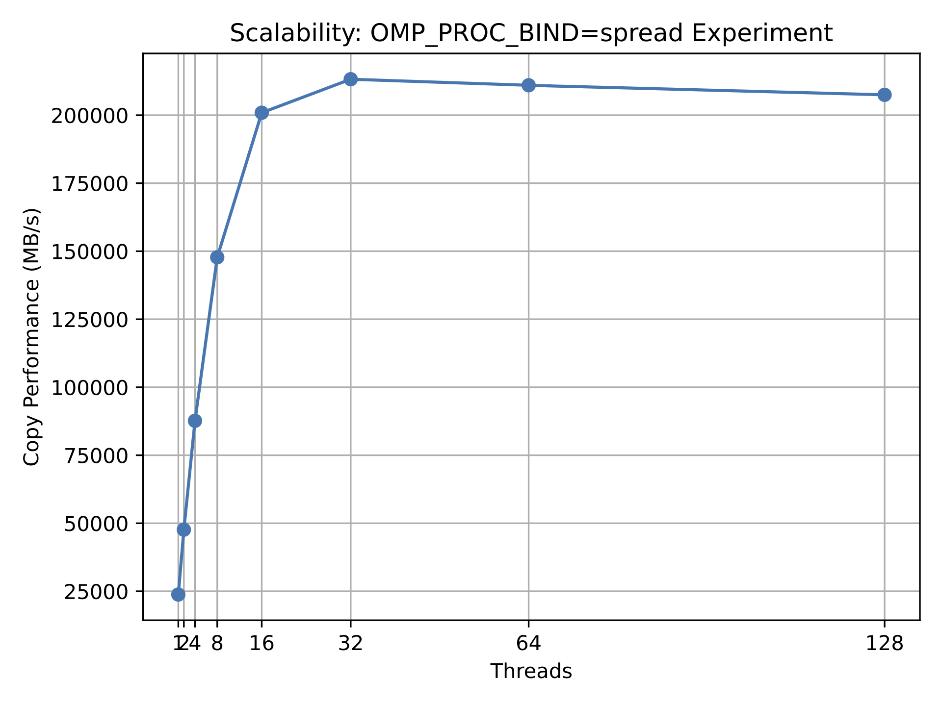
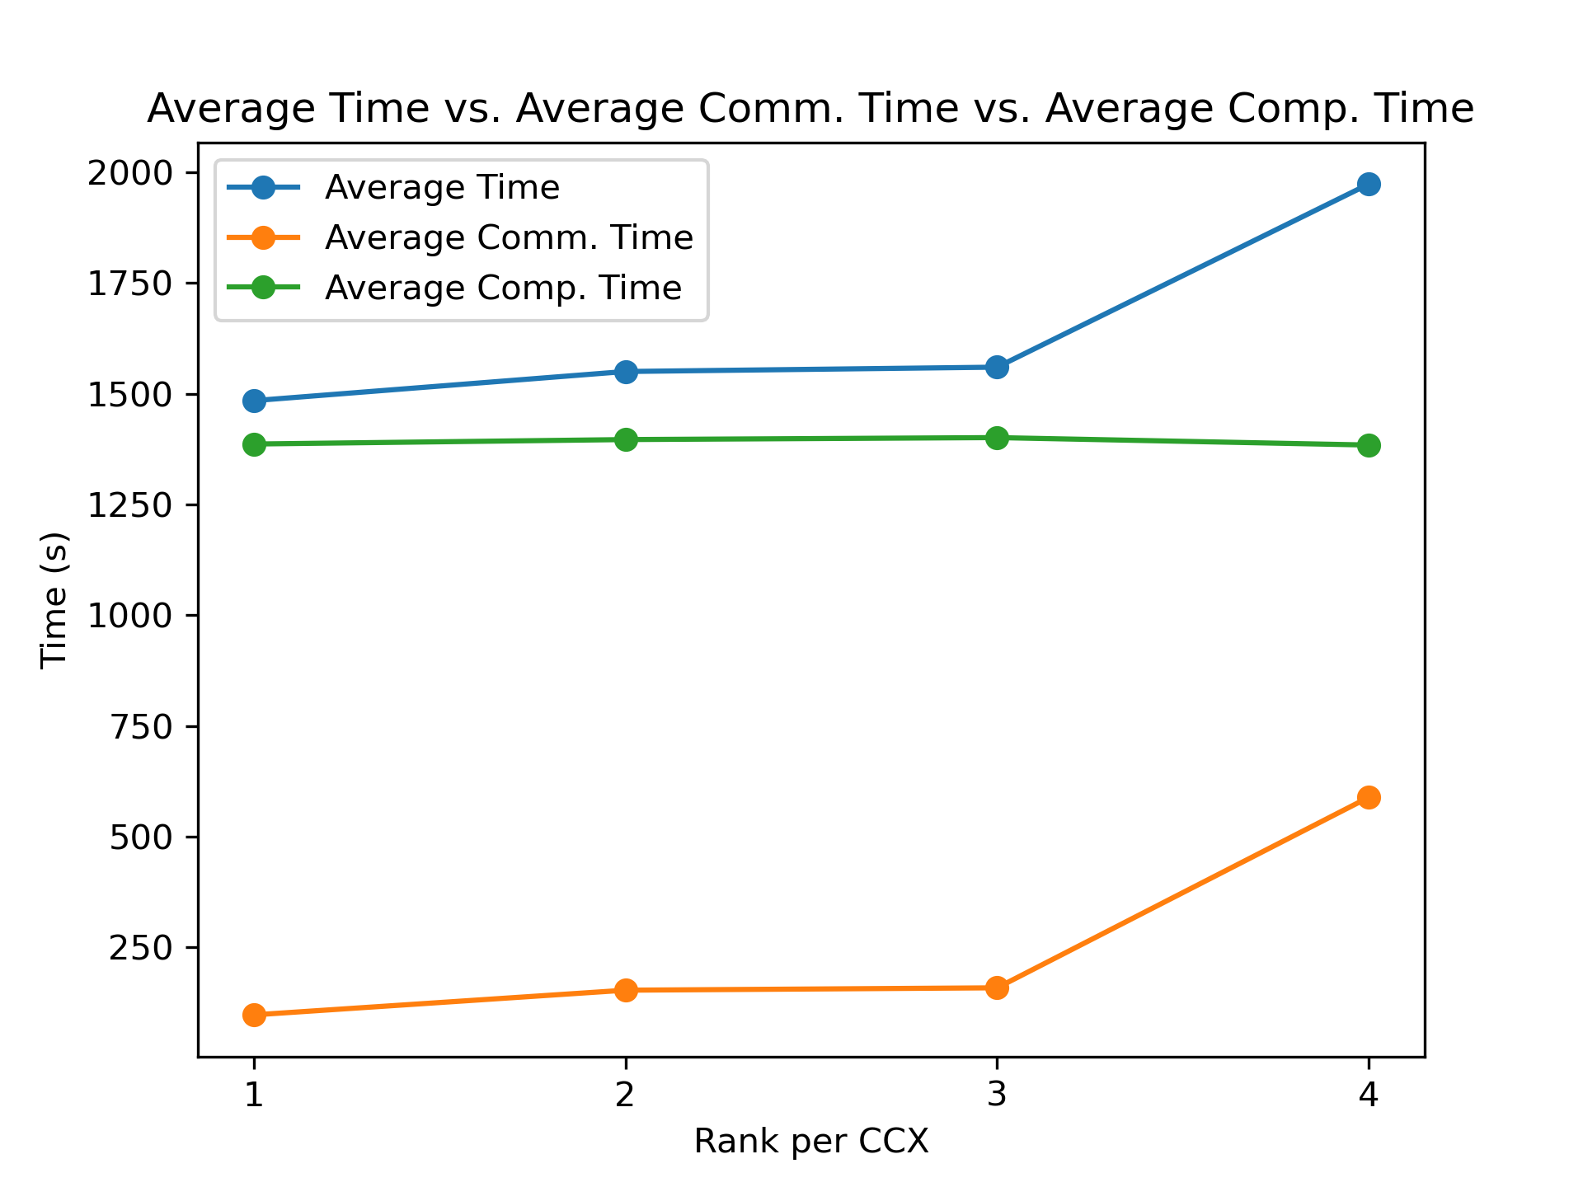
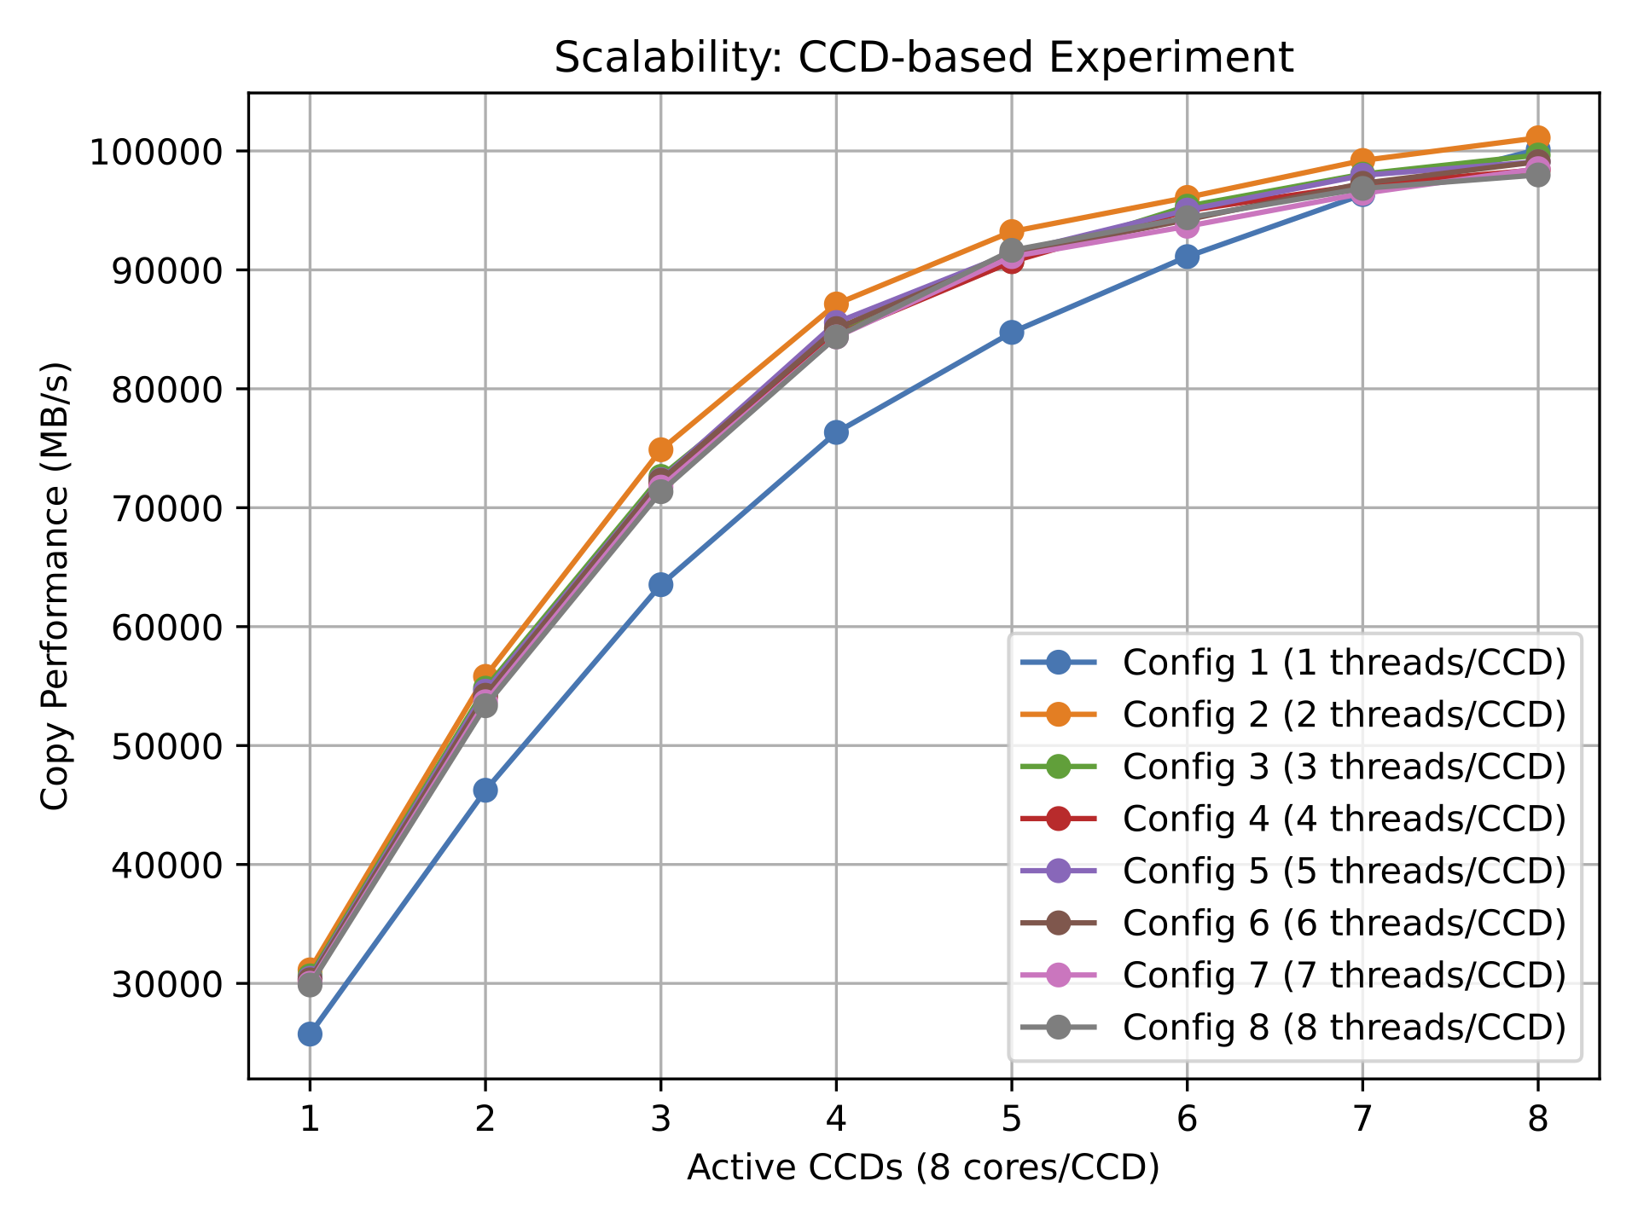
MPI Tuning on Bridges-2
Therefore, map-by L3cache.
--map-by ppr:x:L3cache
To determine the best x, we do some experiments

Slide 11
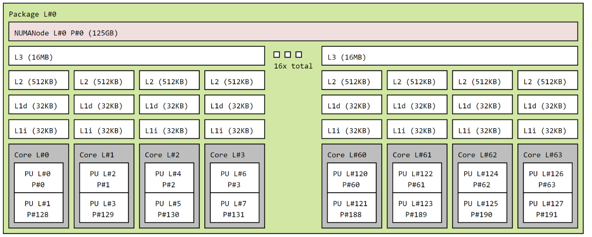
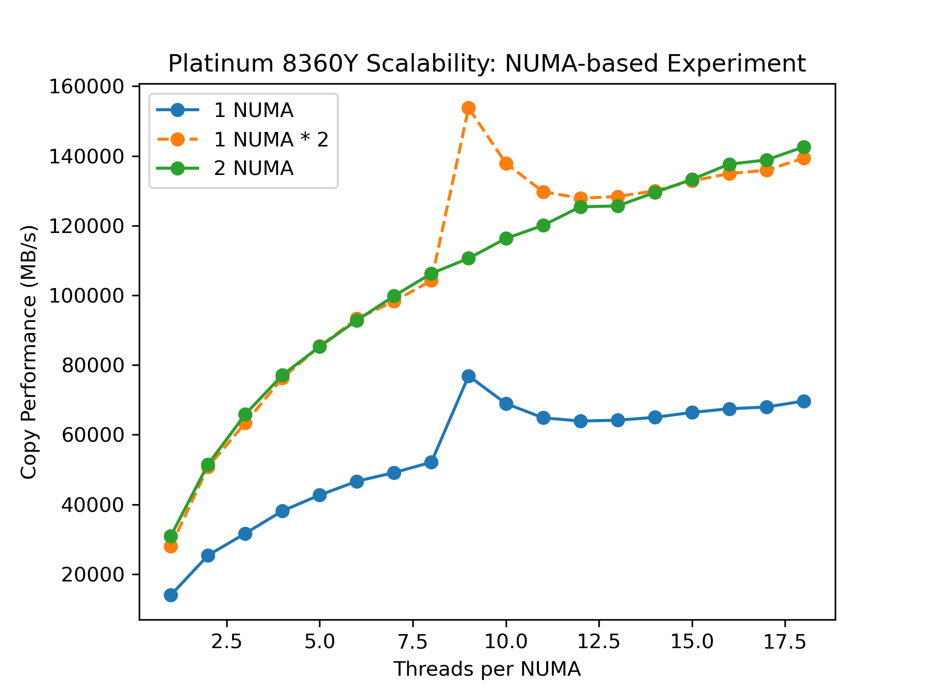
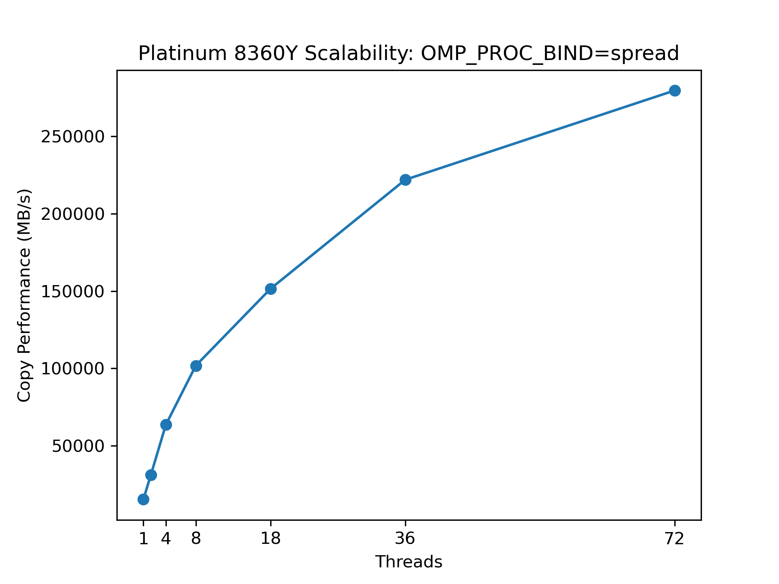
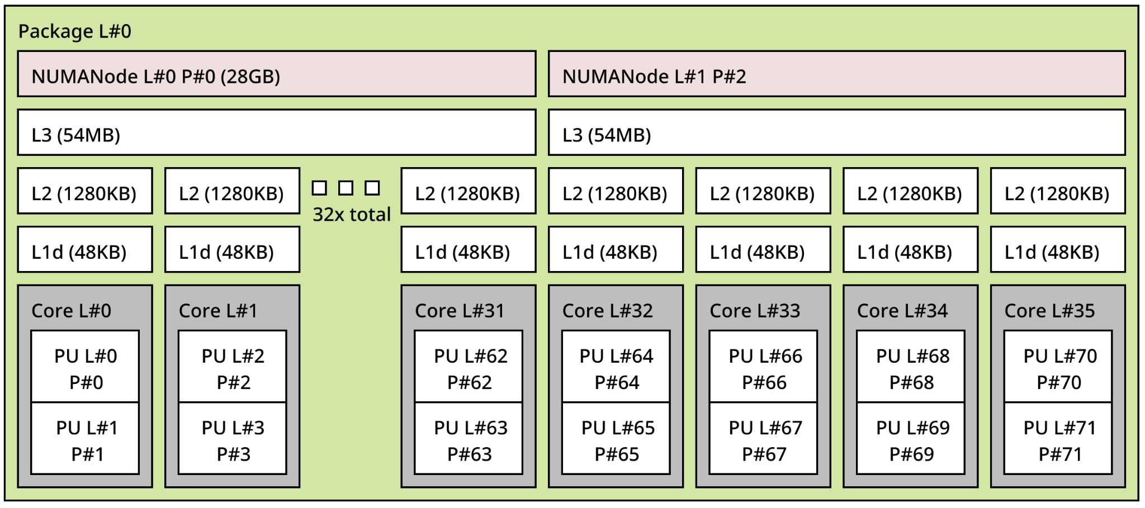
MPI Tuning on FAU
Bridges-2: 1 CCX share 1 L3cache
FAU: 1 socket share 1 L3cache

Slide 12
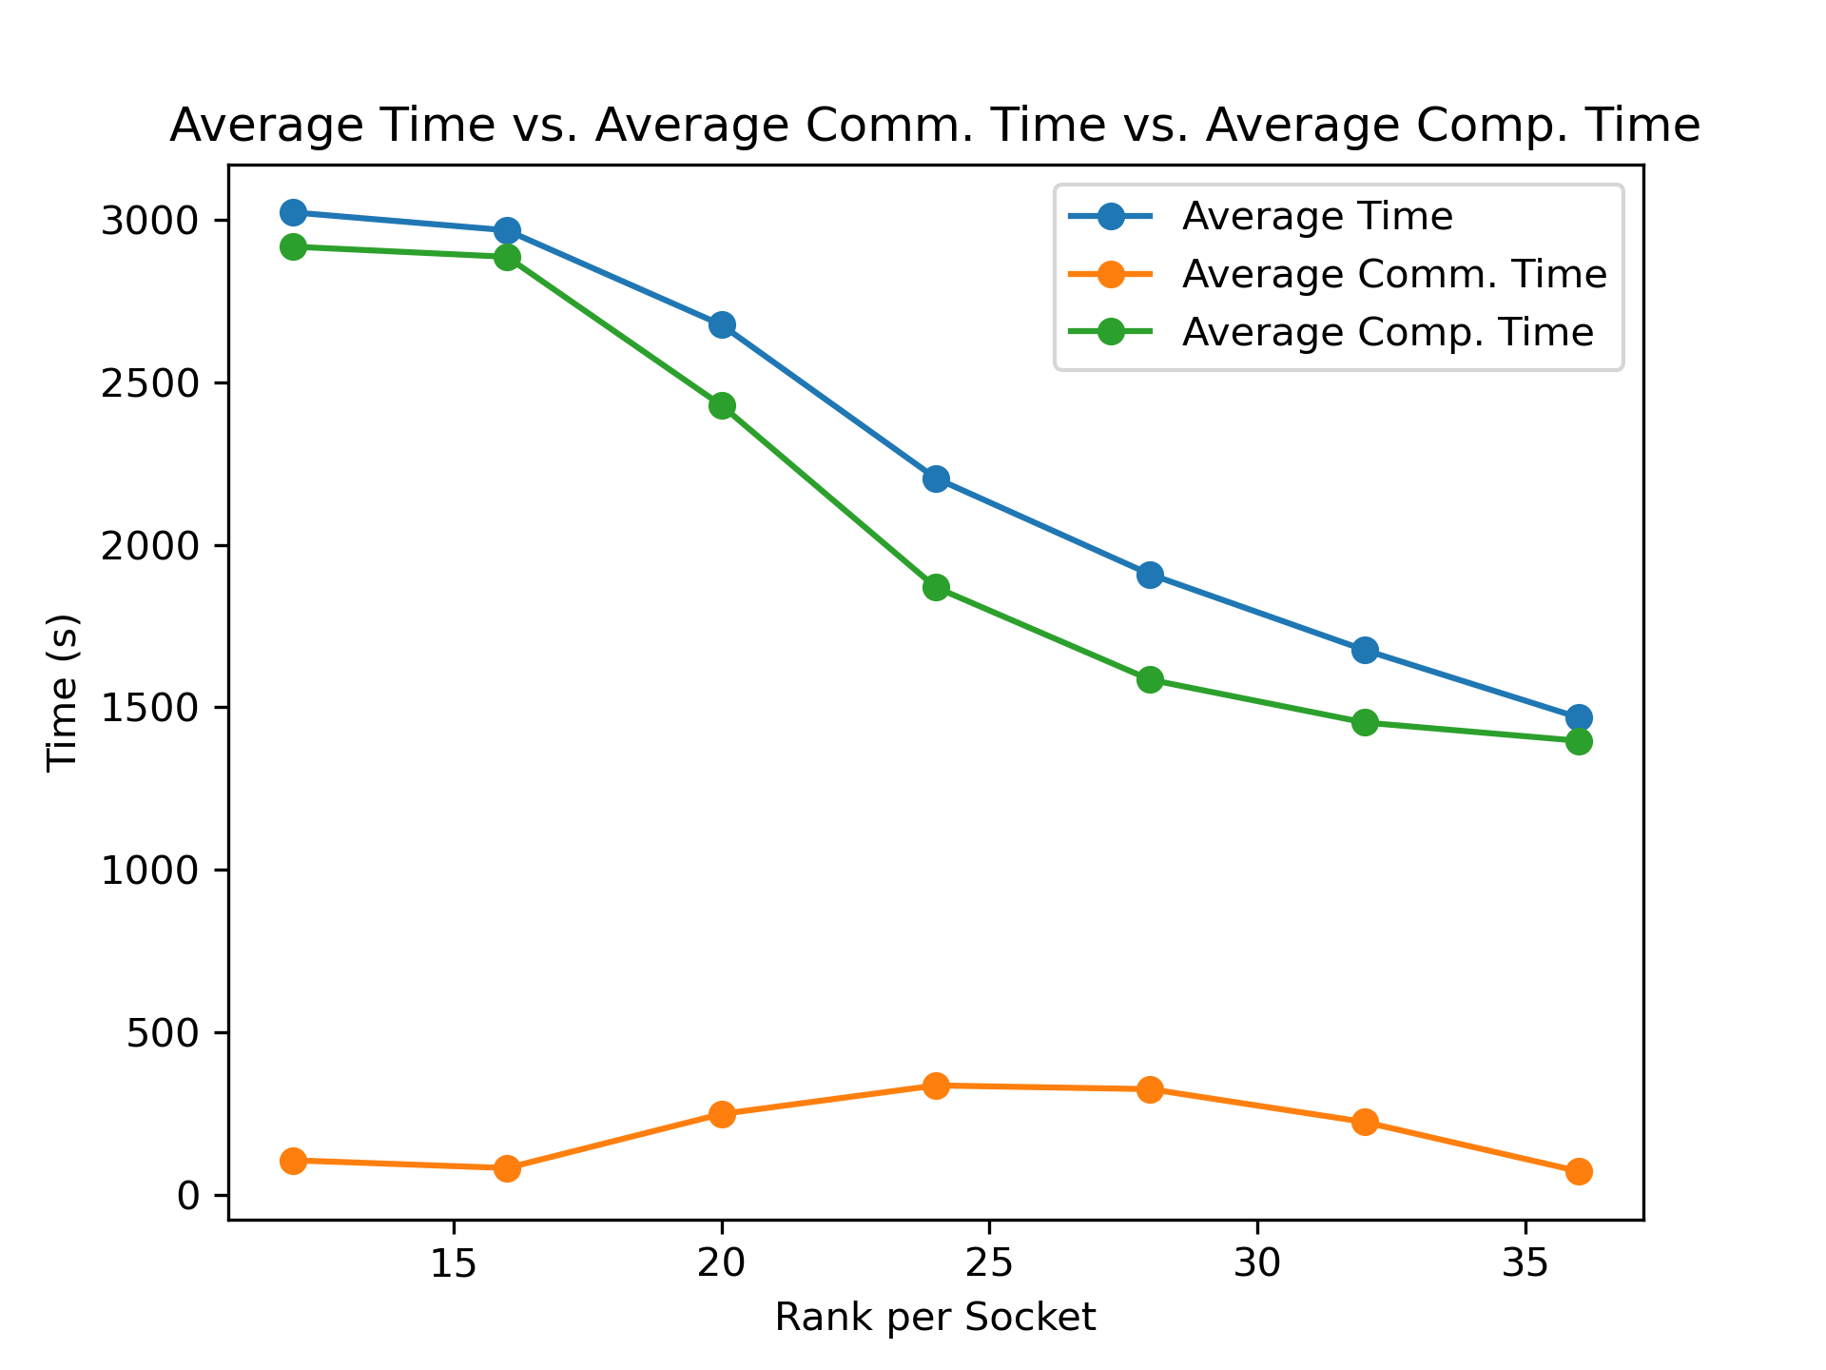
MPI Tuning on FAU
On Bridges-2, 1 threads/CCX is capable of utilizing the entire bandwidth
On FAU, the more cores the better
Simply -np 288 will have the best performance

Slide 13
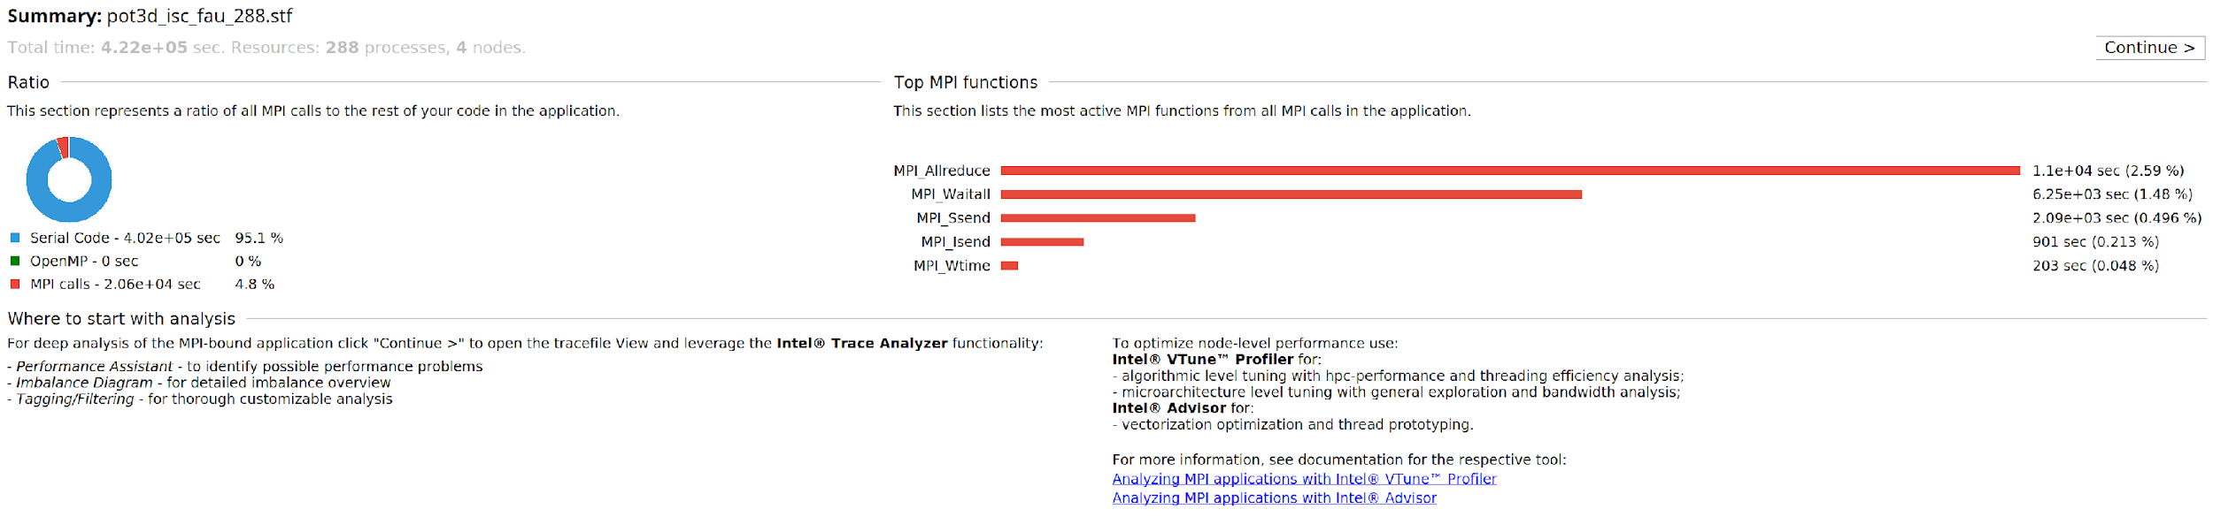
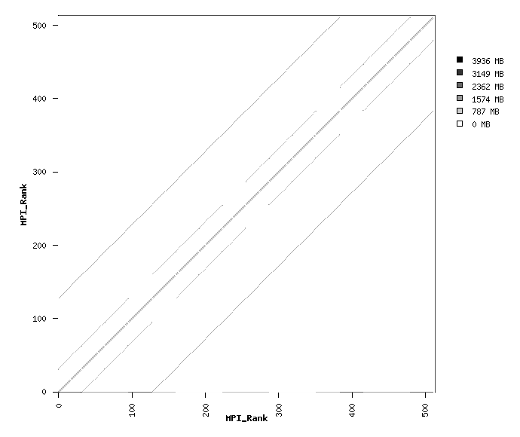
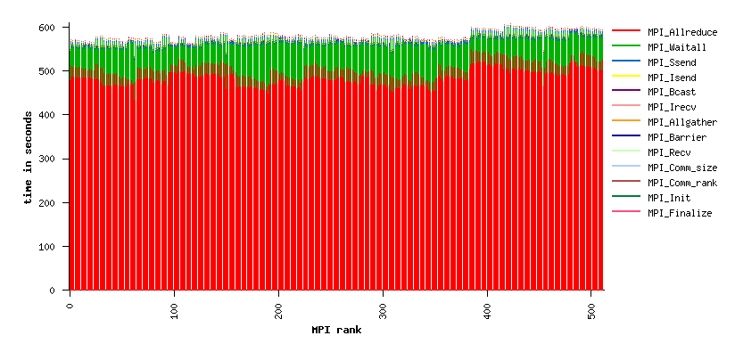
MPI Profiling
MPI profiling using IPM and ITAC
No communication imbalance
4*4*32 3D grid. A rank communicate with front, back, left, right, up and down ranks
The MPI communication time accounts for only 5%. so we decide not to optimize MPI, but instead looking at other areas

Slide 14
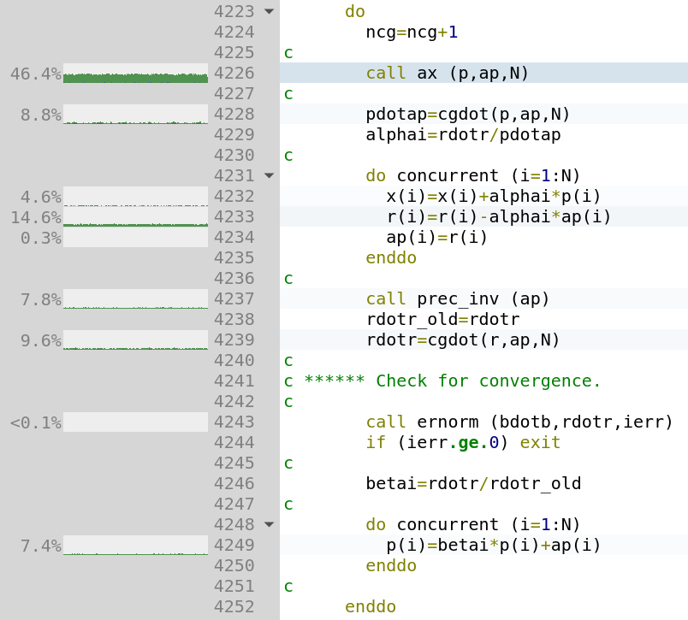
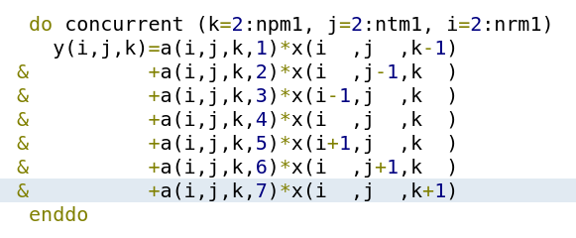
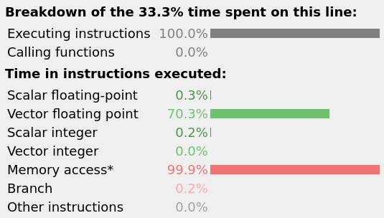
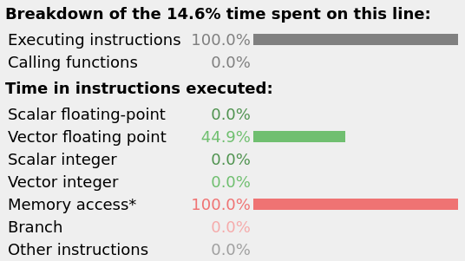
Code Profiling
Memory bound

Slide 15
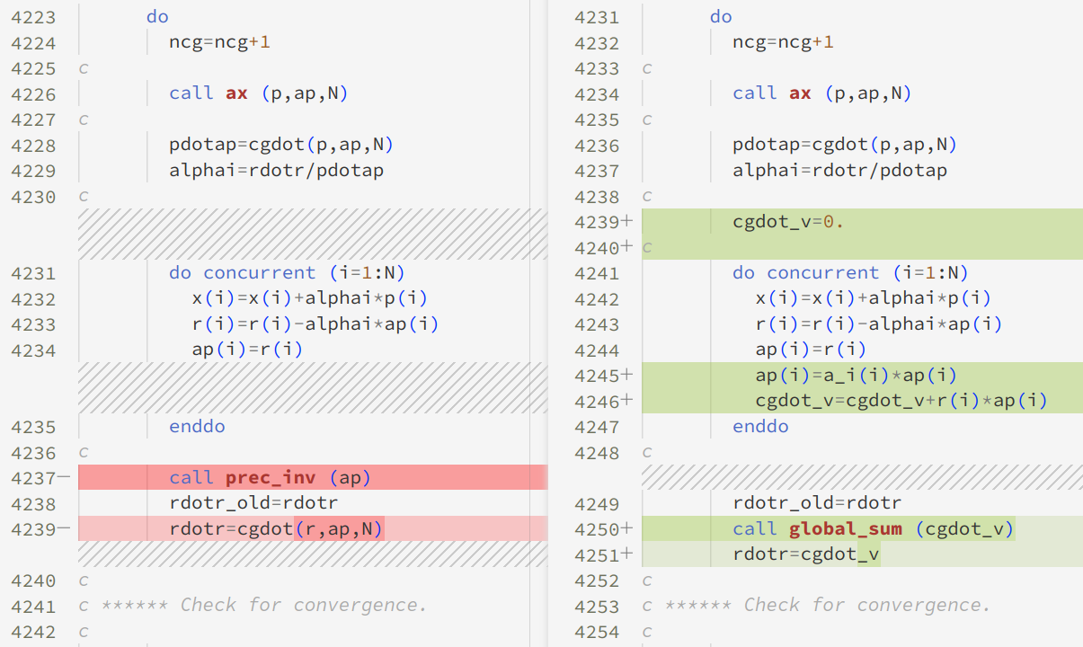
Code Profiling
In isc2023 testsuite, ifprec=1, prec_inv(x) executes x = a_i * x
We can move the the code in prec_inv, cgdot to the loop at Line 4231-4235
Bridges-2 CPU
Before: 1704s
After: 1484s
Bridges-2 GPU
Before: 626s
After: 550s
FAU
Before: 1467s
After: 1581s

Slide 16
GPU Bonus
Compilation：
Different versions of CUDA and NVHPC:
No significant change
Interprocedural analysis and optimization: (-Mipa=fast,inline | CMAKE_INTERPROCEDURAL_OPTIMIZATION)
Requirement: NVHPC <= 22.1, CUDA <=10.2
Apply IPO to both HDF5 and POT3D: speed up less than 1%, consider as error
cuSparce:
Requirement: CUDA >= 11.3
Obtain the 2x speed with ifprec=2

Slide 17
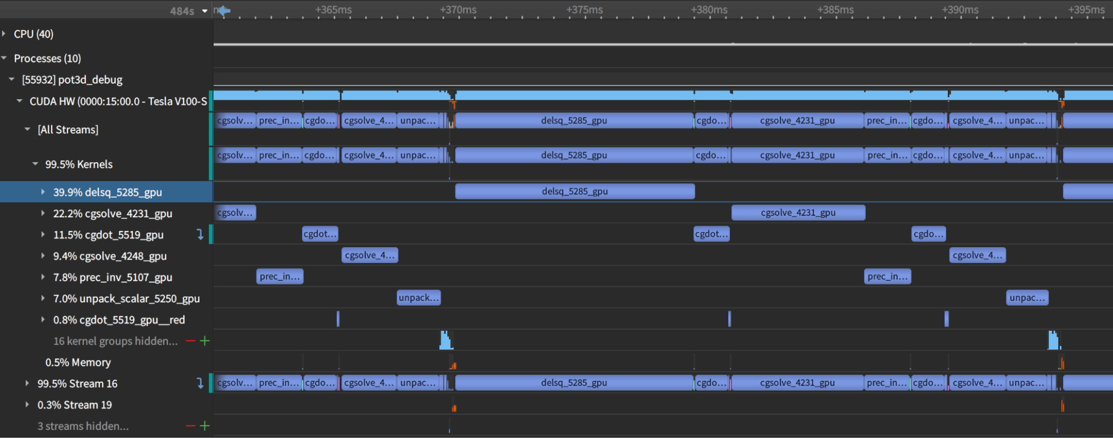
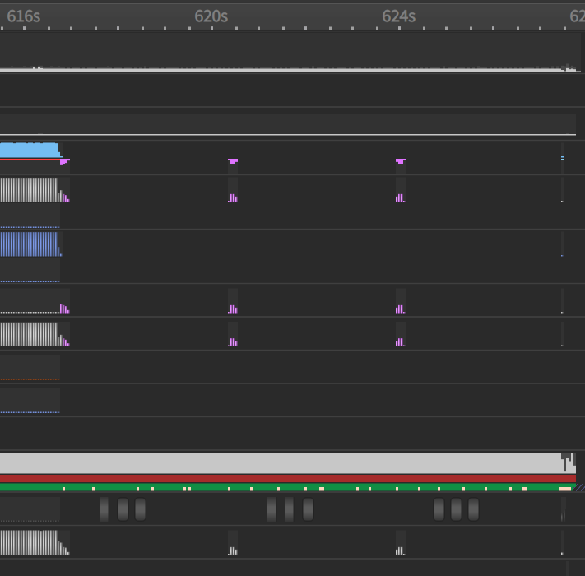
GPU Bonus
Repetition of several functions that take up almost all of the time. Small amount of MPI time near the end of the phase.

Slide 18
Result
On Bridges-2 CPU: 1484s
On Bridges-2 GPU: 550s (legacy), 327s (with cuSparse)
On FAU: 1478s

Slide 19
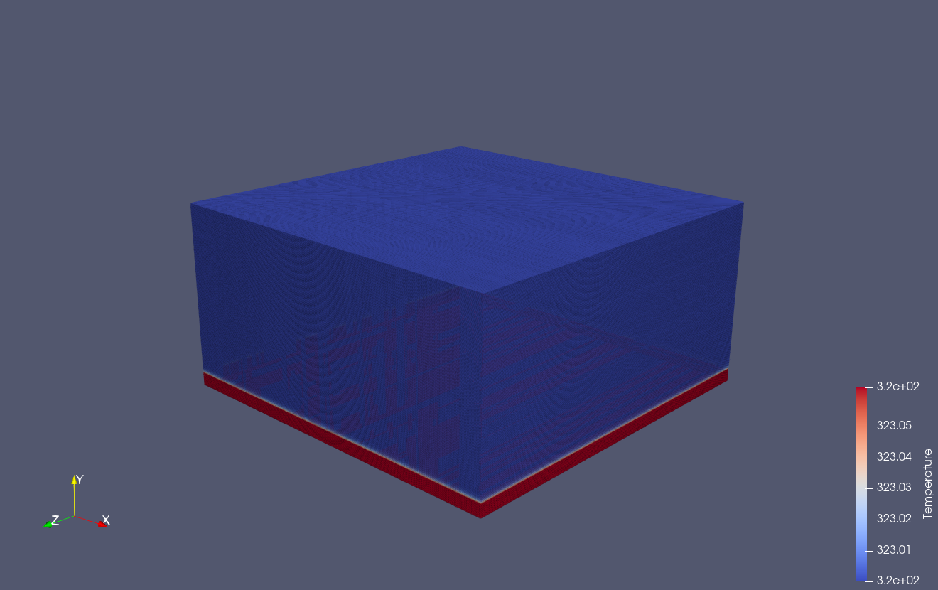
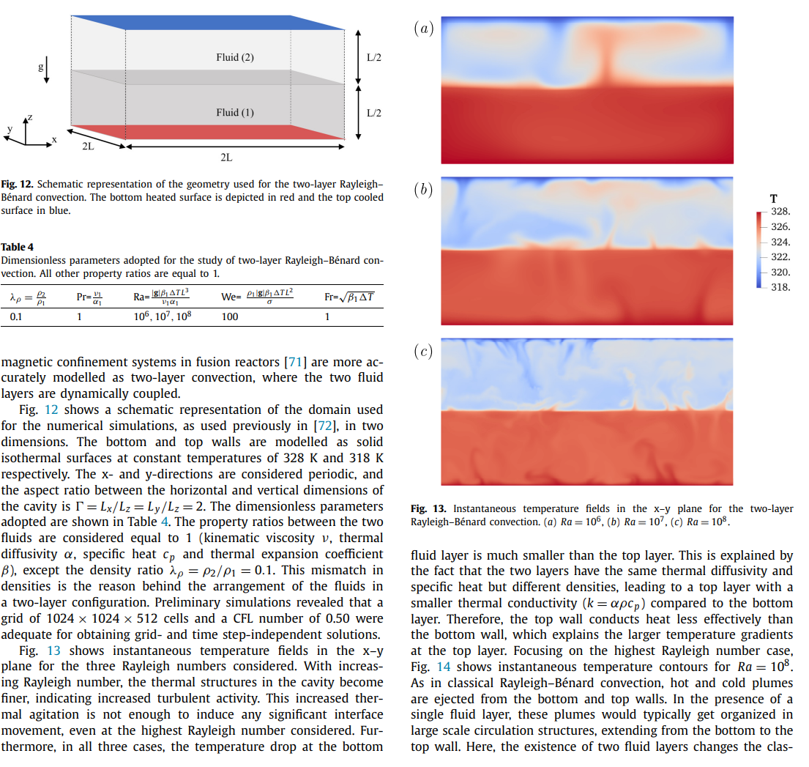
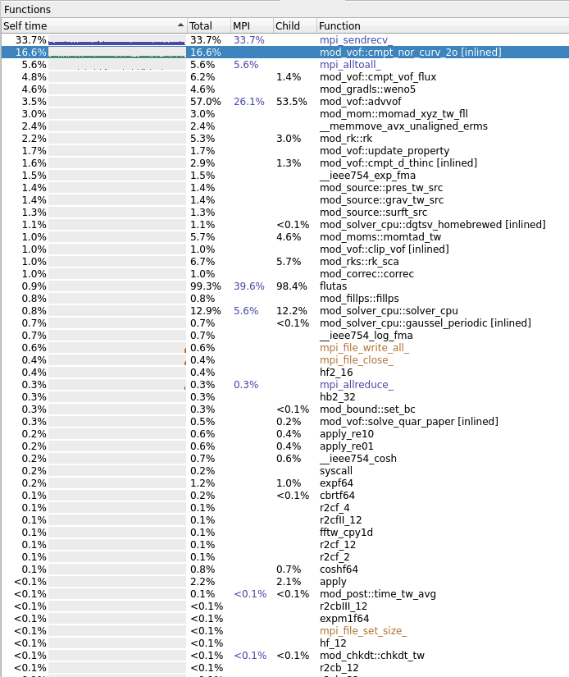
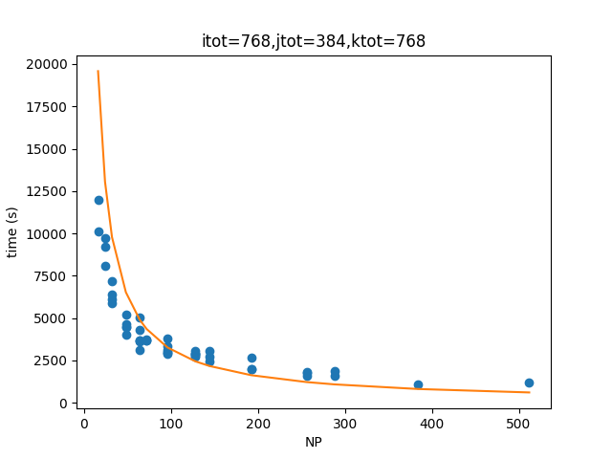
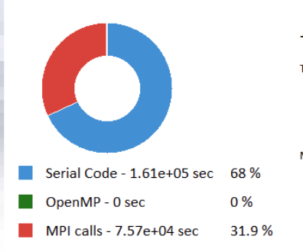
FluTAS
MPI Profiling
Communication Feature
Scalability Graph
Parameter Selection
Analysis of FAU and Bridges
Speed-up Tricks

Slide 20
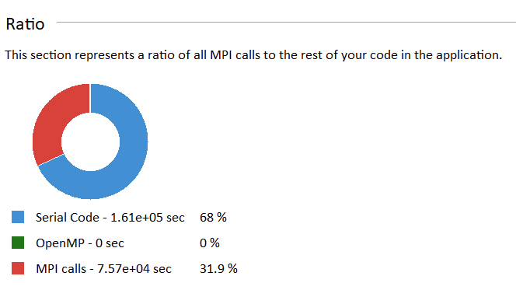
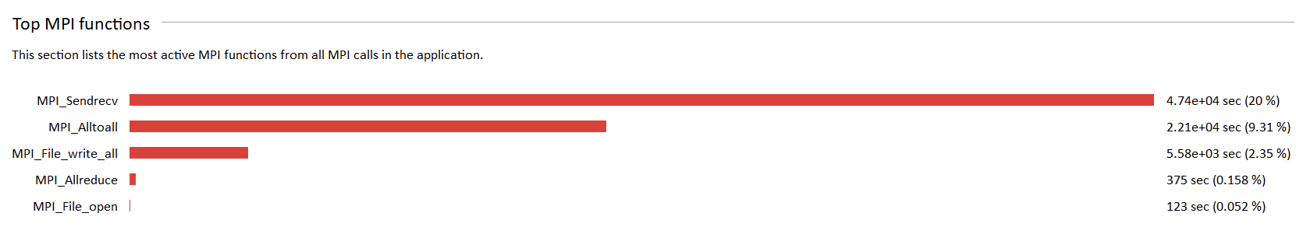
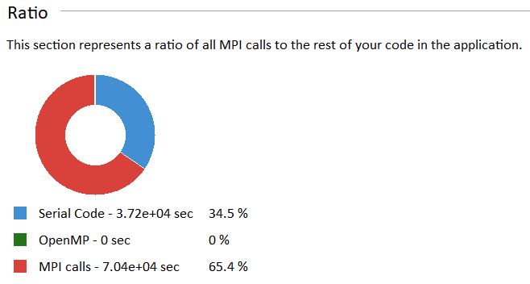
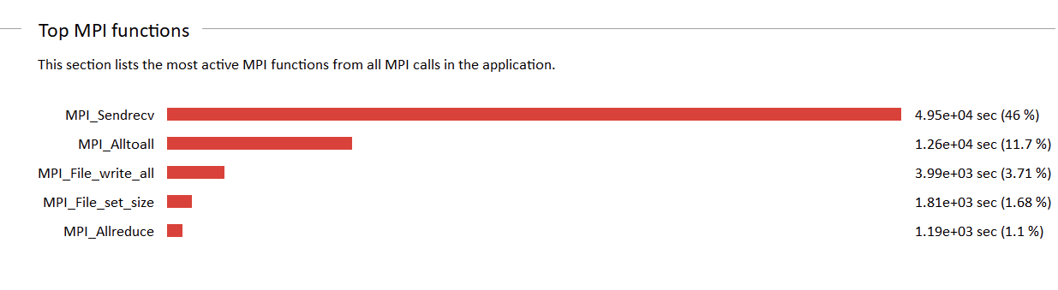
MPI Profiling
fau, 4 nodes, 288 processes
bridges-2, 4 nodes, 512 processes

Slide 21
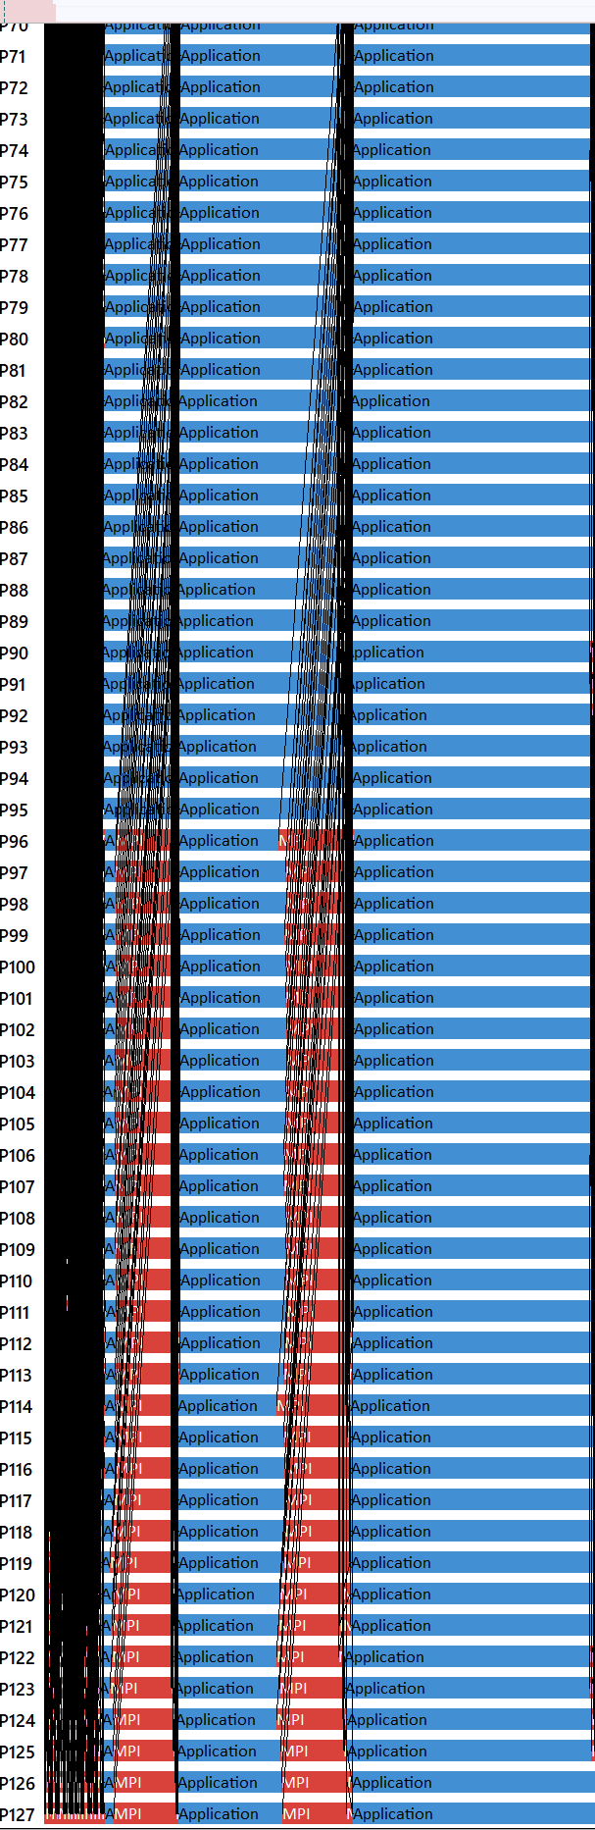
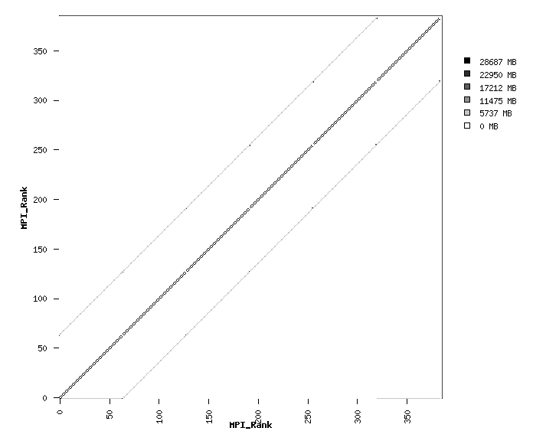
MPI Profiling: communication feature
Dim1*Dim2 2D grid
Each rank communicates with 4 neighboring ranks

Slide 22
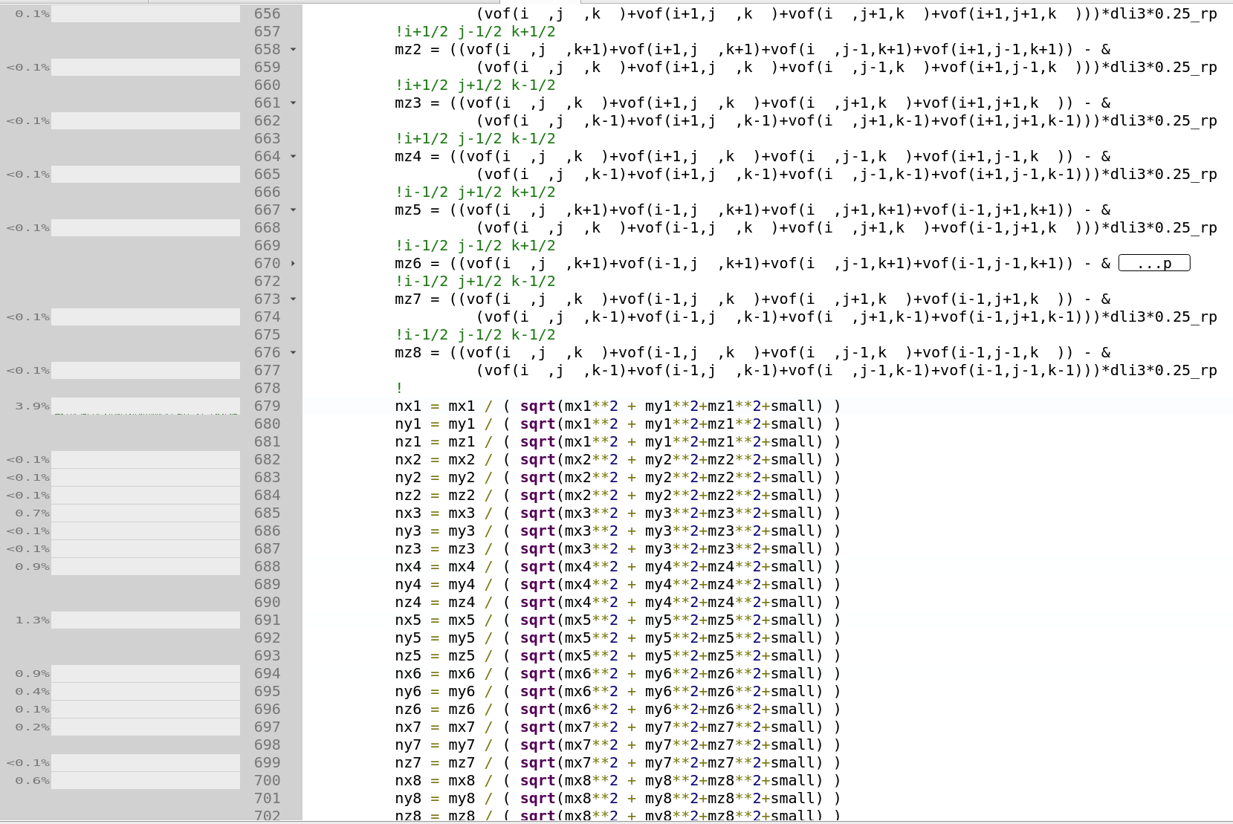
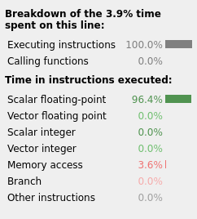
Computing bound
The main computing bottleneck is the floating point computation.
FFTW is not a performance bottleneck.

Slide 23
FluTAS: software performance conclusion
Overall Conclusion:
For the given input and settings (two_layer_rb,first frame)
FluTAS is both Computing bound and MPI bound.

Slide 24
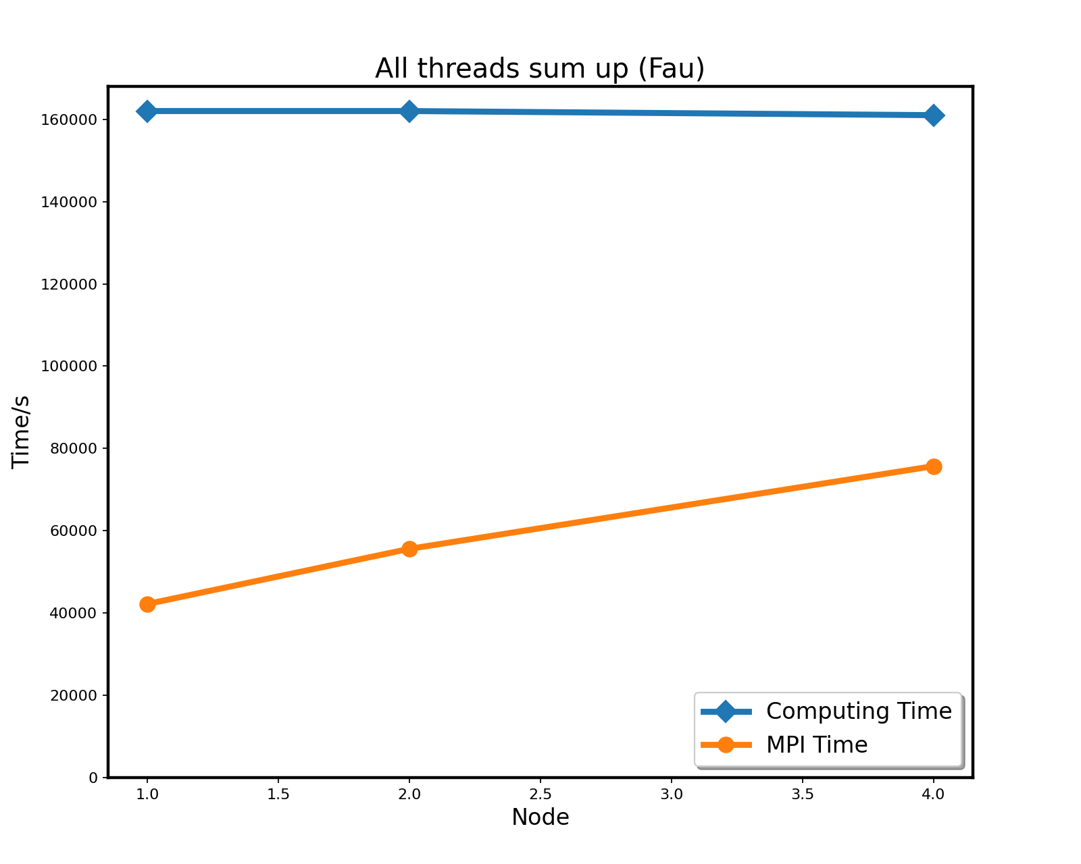
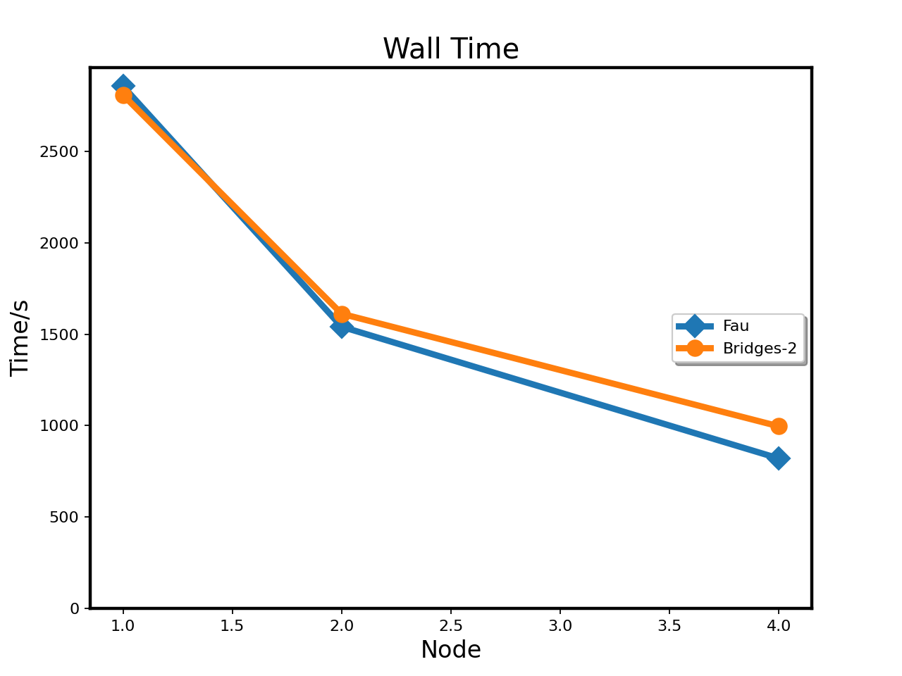
Scalability Graph: Strong Scaling
Running FluTAS with full PPN on 1,2,4 nodes respectively.
Fixed workload. Strong Scaling

Slide 25
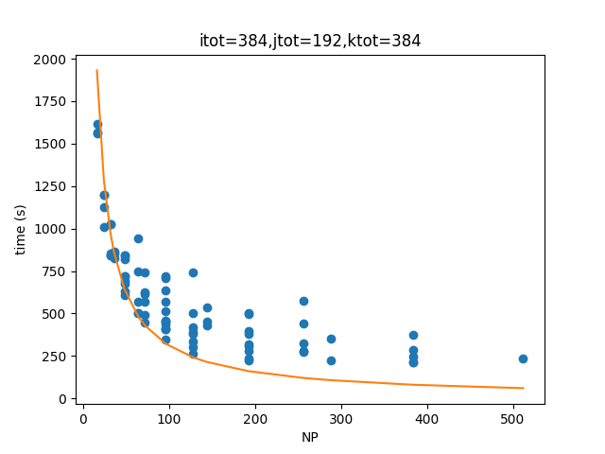
Scalability Graph: Strong Scaling
Running FluTAS with different number of cores. Indicating the Strong Scaling property.

Slide 26
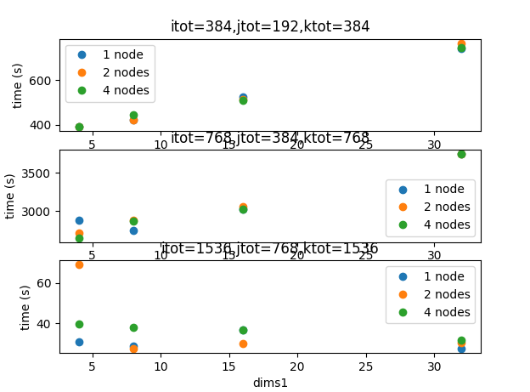
Parameter Selection
Our given task is to simulate the Two-layer Rayleigh-Bénard convection for one frame.
In this situation, reduce dims1 (parameter in dns.in)
will boost its speed. This may be due to the iosopy property on the xOz surface.
Out of Memory
The visualization of the software result of FluTAS by paraview

Slide 27
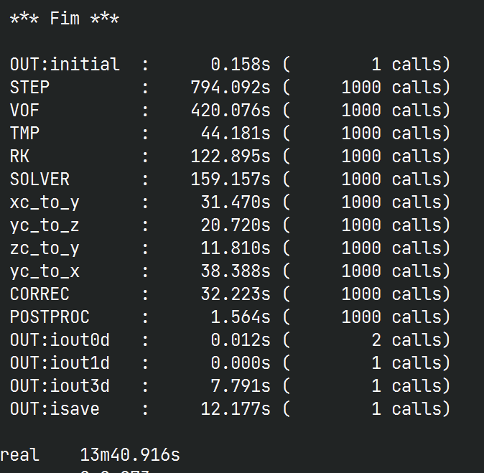
FAU
On 4-nodes, Computational bottlenecks have a greater impact than communication bottlenecks.
The more cores, the better.
So we just use full PPN.
Final Result:

Slide 28
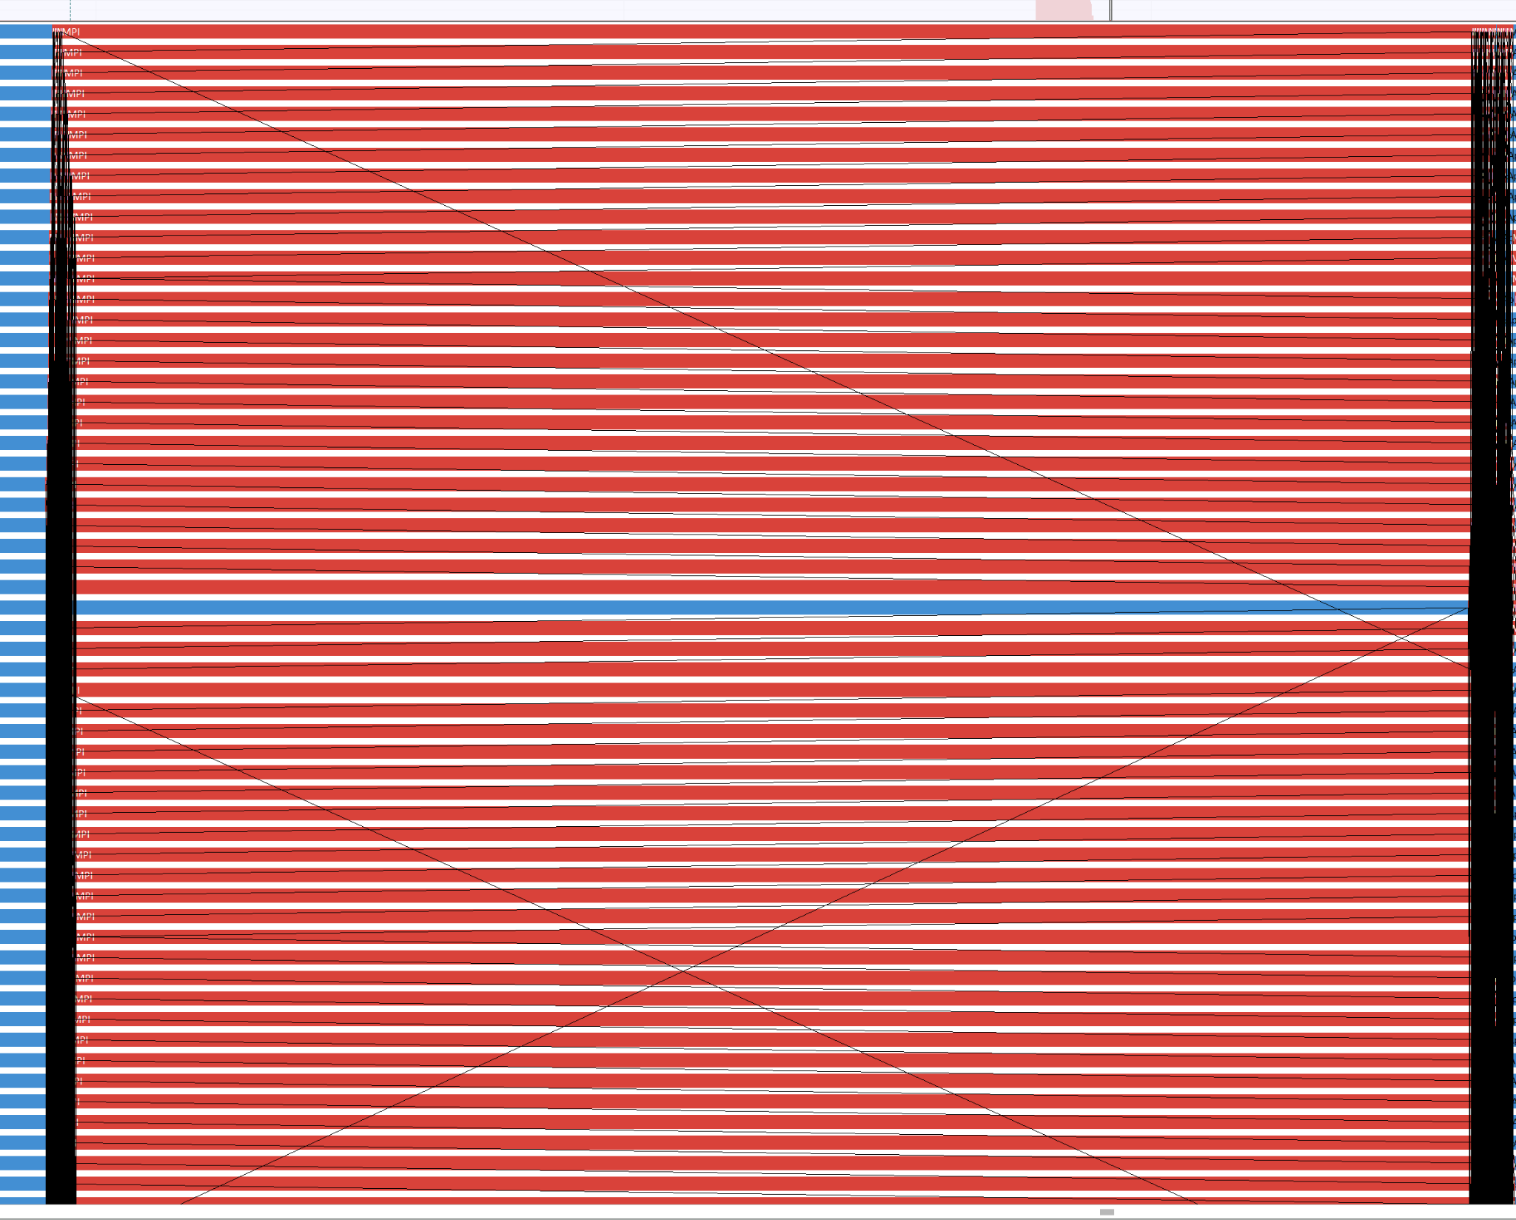
Bridges-2: Deficiency
There is a “guard process” on RM.
Background procedures “guard process” significantly block the computing process.
We don't have permission to change the priority.
All ranks were waiting for the blocked one.
(Intel ITAC a communication profiler)

Slide 29
Bridges-2: Deficiency
Choose a PPN less than 128.
dim1 and dim2 should divide itot and jtot.
127 is a prime number, cannot be divided, too bad!
We choose 96=6*16

Slide 30
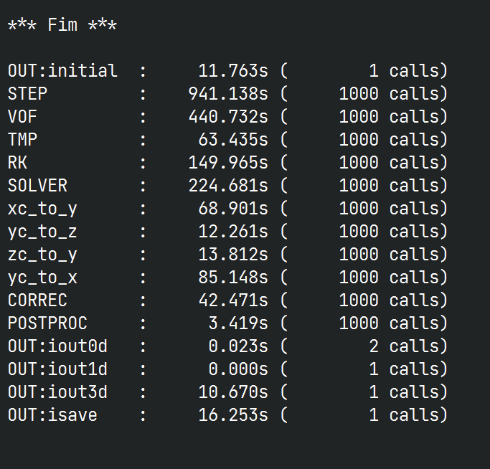
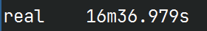
Bridges-2: speed up
Final Result:
Bridges-2: 1 CCX share 1 L3 cache
Each 3 ranks bound to 1 CCX
openmpi: --map-by ppr:3:l3cache
Compared with the same parameter previous result, this approach speeds up by 20%

Slide 31
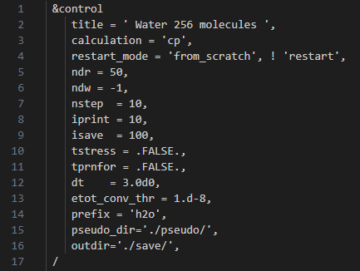

Quantum ESPRESSO
Primary Input Analysis
CP-W256
Supercell_11layer

Slide 32


Quantum ESPRESSO
We first using ITAC profiler to analyze two input.
Sum : 142.7s
MPI Bound!
Sum : 1505.8s

Slide 33


Quantum ESPRESSO
MPI_Alltoall
Sends data from all to all processes

Slide 34



Quantum ESPRESSO
Some strategies to solve it :
- MPI rank configuration change
- Run with different libraries
- Code change
Scalability of CP-W256 input in bridges-2 cluster

Slide 35


Quantum ESPRESSO
Some strategies to solve it :
- MPI rank configuration change
- Run with different libraries
- Code change
Scalability of supercell input in bridges-2 cluster

Slide 36

Quantum ESPRESSO
Some strategies to solve it :
- MPI rank configuration change
- Run with different libraries
- Code change
One L3 cache
Four cores
Bind to L3 or core

Slide 37

Quantum ESPRESSO
Htop show

Slide 38
Quantum ESPRESSO
Bridges_CP_binding_test
Rank | ppr | socket:PE | CPU time | WALL time
8 | 1 | 64 | 7m47.69s | 7m52.39s
16 | 2 | 32 | 3m41.35s | 3m44.78s
32 | 4 | 16 | 2m 5.87s | 2m 8.73s
64 | 8 | 8 | 1m29.54s | 1m30.38s
128 | 16 | 4 | 57.96s | 1m 6.08s
256 | 32 | 2 | 54.82s | 58.63s
512 | 64 | 1 | 2m32.03s | 2m38.13s

Slide 39
Quantum ESPRESSO
Bridges_supercell_binding_test
Rank | ppr | socket:PE | CPU time | WALL time
8 | 1 | 64 | 1h33m | 1h34m
16 | 2 | 32 | 47m17.38s | 47m43.47s
32 | 4 | 16 | 26m14.23s | 26m34.14s
64 | 8 | 8 | 17m 3.66s | 17m14.89s
128 | 16 | 4 | 15m12.35s | 15m29.88s
256 | 32 | 2 | 15m53.56s | 16m 9.34s
512 | 64 | 1 | 25m20.61s | 25m48.22s

Slide 40


Quantum ESPRESSO
Some strategies to solve it :
- MPI rank configuration change
- Run with different libraries
- Code change
We also tried to use some other combinations of compilers and libraries:
gcc + AOCL on bridges2
icc + AOCL on bridges2
AOCC + AOCL on our own cluster
gcc + Intel MKL on AMD Zen(bridges2)
icc + ELPA on Fau
Command : mpirun -N … -pd .true. …

Slide 41


Quantum ESPRESSO
Some strategies to solve it :
- MPI rank configuration change
- Run with different libraries
- Code change
Serial code part has high proportion time cost in mkl basic algorithm library

Slide 42

Quantum ESPRESSO
GPU Bonus
When the competition starts, the latest version of QE is 7.1, CP in which may fail when CUDA aware MPI is enabled.
The result of 7.1 is obtained without CUDA aware MPI.
Version | Input | GPUs | WALL time
7.1 | CP-W256 | 1 | 3m4.96s
7.1 | CP-W256 | 4 | 1m32.70s
7.2 | CP-W256 | 4 | 59.48s
7.1 | supercell | 1 | OOM
7.1 | supercell | 4 | 5m0.86s
7.2 | supercell | 4 | 3m53.91s

Slide 43


Quantum ESPRESSO
Nvidia NSys profiling result
Pageable Memcpy from device to host or host to device
Thoughts: Use pinned memcpy as much as possible, overlap memcpy and computation through multiple CUDA stream

Slide 44
Quantum ESPRESSO
Tricks
#!/bin/bash
cd $1
APP="$2"
me=`hostname`
lrank=$OMPI_COMM_WORLD_LOCAL_RANK
case ${lrank} in
0)
echo "host=$me rank= $OMPI_COMM_WORLD_RANK lrank = $lrank cores=$CPU_CORES_PER_RANK bin=$APP"
export CUDA_VISIBLE_DEVICES=0; numactl --cpunodebind=0 taskset -c 0 $APP
;;
1)
echo "host=$me rank= $OMPI_COMM_WORLD_RANK lrank = $lrank cores=$CPU_CORES_PER_RANK bin=$APP"
export CUDA_VISIBLE_DEVICES=1; numactl --cpunodebind=0 taskset -c 1 $APP
;;
2)
echo "host=$me rank= $OMPI_COMM_WORLD_RANK lrank = $lrank cores=$CPU_CORES_PER_RANK bin=$APP"
export CUDA_VISIBLE_DEVICES=2; numactl --cpunodebind=1 taskset -c 20 $APP
;;
3)
echo "host=$me rank= $OMPI_COMM_WORLD_RANK lrank = $lrank cores=$CPU_CORES_PER_RANK bin=$APP"
export CUDA_VISIBLE_DEVICES=3; numactl --cpunodebind=1 taskset -c 21 $APP
;;
Bind MPI ranks to cores based on the allocated GPU and CPU topology found with `nvidia-smi topo -m`.
But it is not utilized in our final runs - we tried to find an empty server where we allocated a full CPU0 with 4 GPUs connected to it. As “Noisy Neighbor” effect is avoided, its performance is highest.

Slide 45
Quantum ESPRESSO
Difficulties
There is a process limitation (144) in the bridge cluster of Arm-forge profiler. We can't see comprehensive code and running function information beyond 2 nodes.
The two clusters are AMD and Intel machines, respectively. So the same parameters or libraries may not always be suitable for both, and the same goes for the result representation. There are many compilation problems when testing the same operation on both clusters (e.g. compatibility among AOCC, AOCL, OpenMPI, IntelMPI...).
Some libraries in Bridges-2 may not match the runtime version: The NVHPC compiler in Bridges-2 supports up to CUDA 11.8 but the drivers in the GPU nodes are CUDA 12.0. Fortunately, they seem to be compatible when running CP. (Could also be solved by manually install the latest NVHPC)
We could not compile some dependencies of QE with AOCC by Spack in the Bridges-2 cluster due to system environment differences.

Slide 46
Lessons learned
Hardware: We should understand the system's architecture, memory hierarchy, and interconnect topology to ensure efficient parallelization for HPC applications.
Libraries: Selecting the appropriate libraries such as BLAS, LAPACK, FFTW or MPI for different platforms can have a significant impact on performance.
Performance Profiling: Profiling the performance of an application helps identify bottlenecks and opportunities for improvement. Tools such as profilers and trace analyzers can be used to gather valuable insights for optimizing code and communication patterns.
Algorithm Scalability: Measuring and understanding the scalability pattern of an application is important for further optimization and prediction of its performance. Sometimes, it may exhibit super-linear scalability, while other times, the overall running time may even increase when running with more cores.

Slide 47
Team work
Work together to solve compilation issues.
Discuss hardware architectures
Discuss MPI bindings
Discuss code optimizations

Slide 48
Q&A
Allow 5-10 minutes for questions from the judges

